Slide 1



Tutorial
Heart Rate Variability (HRV) analysis
Case study of MarcusVollmer Library
Presented by : Kaïs Siala
Monastir 14th May 2017

Slide 2
Plan
Context
1
2
ECG & PPG
HRV analysis
3
Notes:
2

Slide 3
Plan
Context
1
2
ECG & PPG
HRV analysis
3
Notes:
3

Slide 4

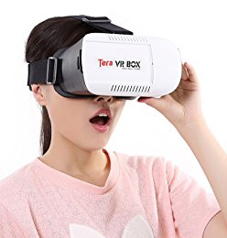
video Out Of Body simulation
Camera

Slide 5
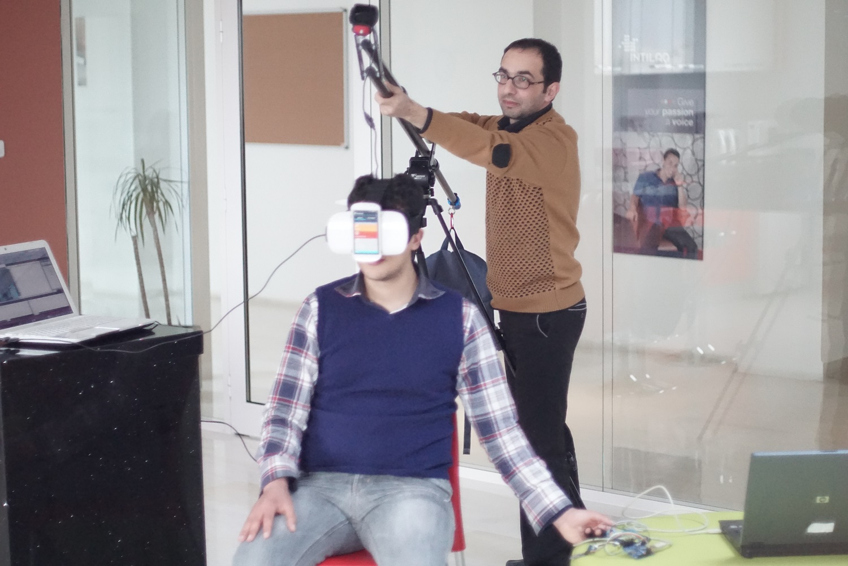
Camera
HMD with Smartphone 2 inside for display
(running Trinus - client)
Smartphone 1 for Head motion detection
(running Sensoduino)
Laptop running Opencv & trinus-server
Physiological measure

Slide 6
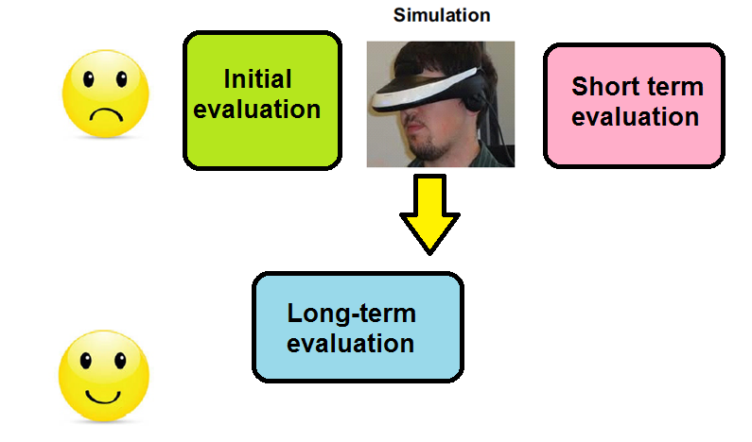
Experimental protocol

Slide 7
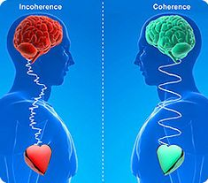
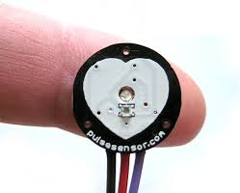

Short term evaluation (biofeedback)
Biofeedback using instruments that provide information on the activity of a body.
  Brainwaves,
  Muscle tone,
  Skin conductance,
  Heart rate variability HRV
  pain perception.
  etc
7

Slide 8
Plan
Context
1
2
ECG & PPG
HRV analysis
3
Notes:
8

Slide 9
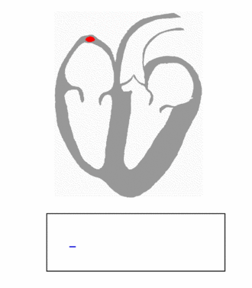
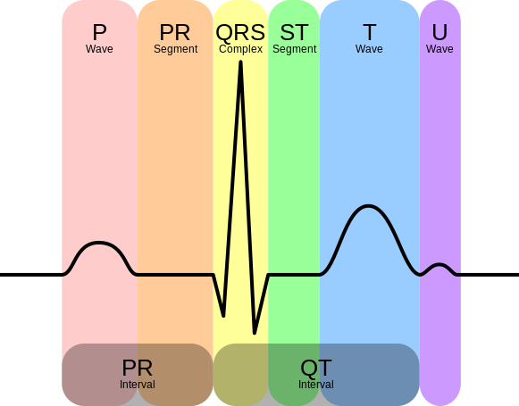

Slide 10
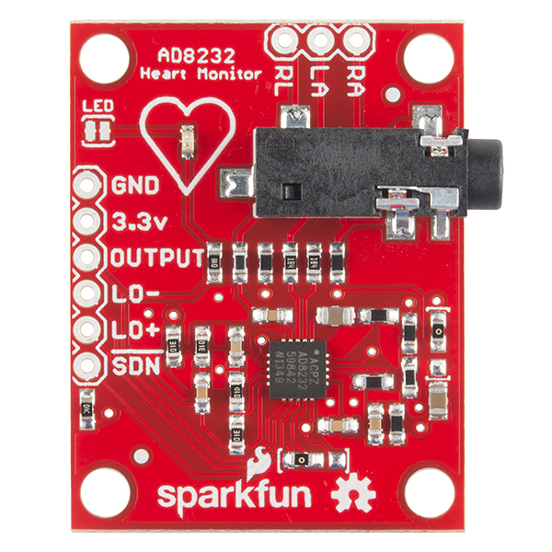
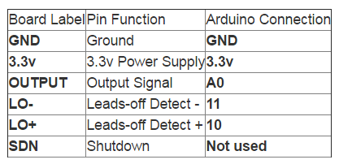

Slide 11
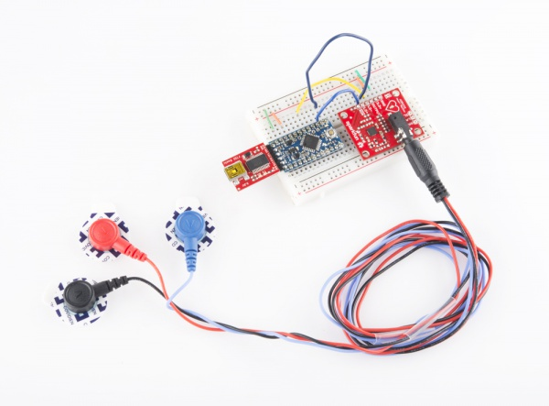
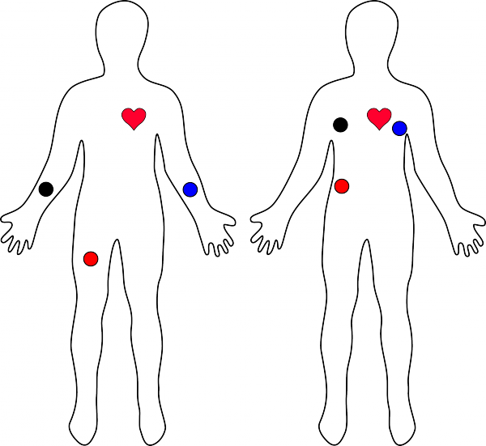

Slide 12
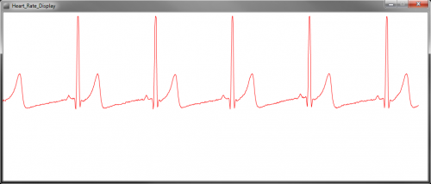

Slide 13
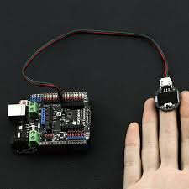
HRV acquisition & processing
PPG sensor on Arduino
Data acquisition by Arduino script
13

Slide 14
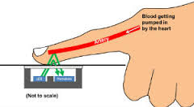
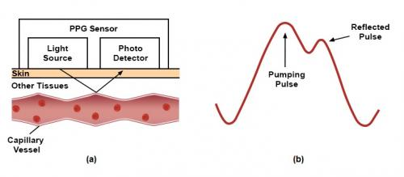
Theoretics in PPG Technology

Slide 15
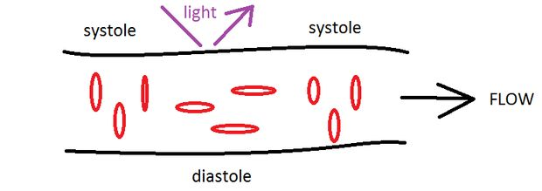
Theoretics in PPG Technology
When the blood is pumped through the body the pressure and consequentially the diameters of the vessels change. If the emitter and detector, both working by a wavelengths which can pass the skin, are placed at a pulsating vessel, the path length of the light will periodically increase and decrease.

Slide 16
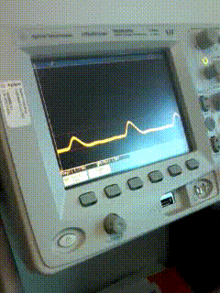
HRV acquisition & processing
Signal visualization on oscilloscope
16

Slide 17
Plan
Context
1
2
ECG & PPG
HRV analysis
3
Notes:
17

Slide 18
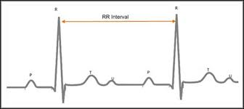

Slide 19
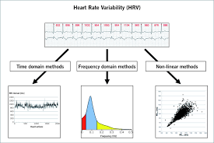

Slide 20
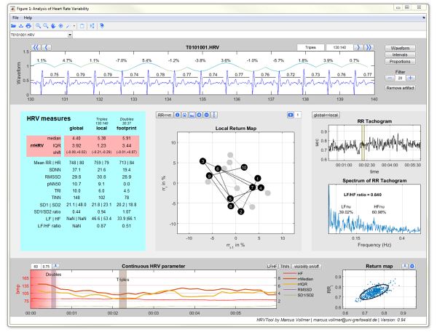
MarcusVollmer Library
20

Slide 21
HRV – signal overview

Slide 22
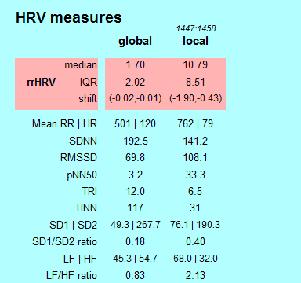
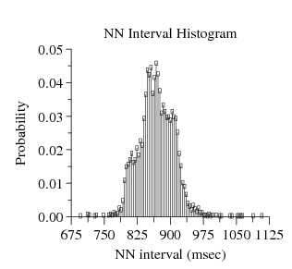

Slide 23
HRV – time domain statistical parameters
AVNN* Average of all NN intervals
SDNN* Standard deviation of all NN intervals
SDANN Standard deviation of the averages of NN intervals in all 5-minute segments of a 24-hour recording
SDNNIDX Mean of the standard deviations of NN intervals in all 5-minute segments of a 24-hour recording
23

Slide 24
HRV – time domain statistical parameters
rMSSD* Square root of the mean of the squares of differences between adjacent NN intervals
pNN50*Percentage of differences between adjacent NN intervals that are greater than 50 ms; a member of the larger
pNNx family
24

Slide 25
HRV – time domain geometrical parameters
TRI HRV triangular index Total number of all NN intervals divided by the height of the histogram of all NN intervals measured on a discrete scale with bins of 7·8125 ms (1/128 s). (Details in Fig. 2)
TINN ms Baseline width of the minimum square difference triangular interpolation of the highest peak of the histogram of all NN intervals (Details in Fig. 2.)
Differential index ms Difference between the widths of the histogram of differences between adjacent NN intervals measured at selected heights (e.g. at the levels of 1000 and 10 000 samples)[21].
Logarithmic index Coefficient ö of the negative exponential curve k · e"öt which is the best approximation of the histogram of absolute differences between adjacent NN intervals[22].

Slide 26
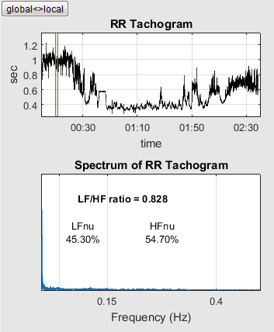
HRV – frequency domain parameters

Slide 27
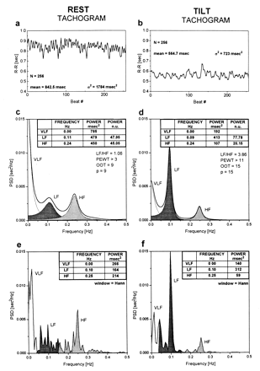

Slide 28
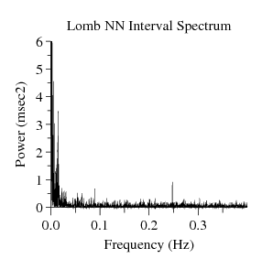
HRV – frequency domain parameters
TOTPWR*Total spectral power of all NN intervals up to 0.04 Hz
ULF Total spectral power of all NN intervals up to 0.003 Hz
VLF* Total spectral power of all NN intervals between 0.003 and 0.04 Hz
LF* Total spectral power of all NN intervals between 0.04 and 0.15 Hz.
HF* Total spectral power of all NN intervals between 0.15 and 0.4 Hz
LF/HF*Ratio of low to high frequency power
28

Slide 29
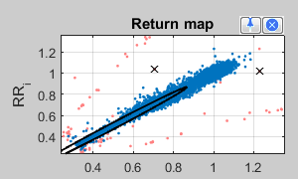
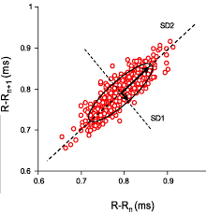
HRV – Poincaré plot
The length of the longitudinal line is defined as the SD2 of the plot data.
The length of the transverse line is defined as the SD1 of the plot data in perpendicular direction.
The Poincaré index (SD1, SD2, SD1/SD2 ratio) was computed.
RR i-1
29

Slide 30

HRV – Continuous HRV parameters
30

Slide 31
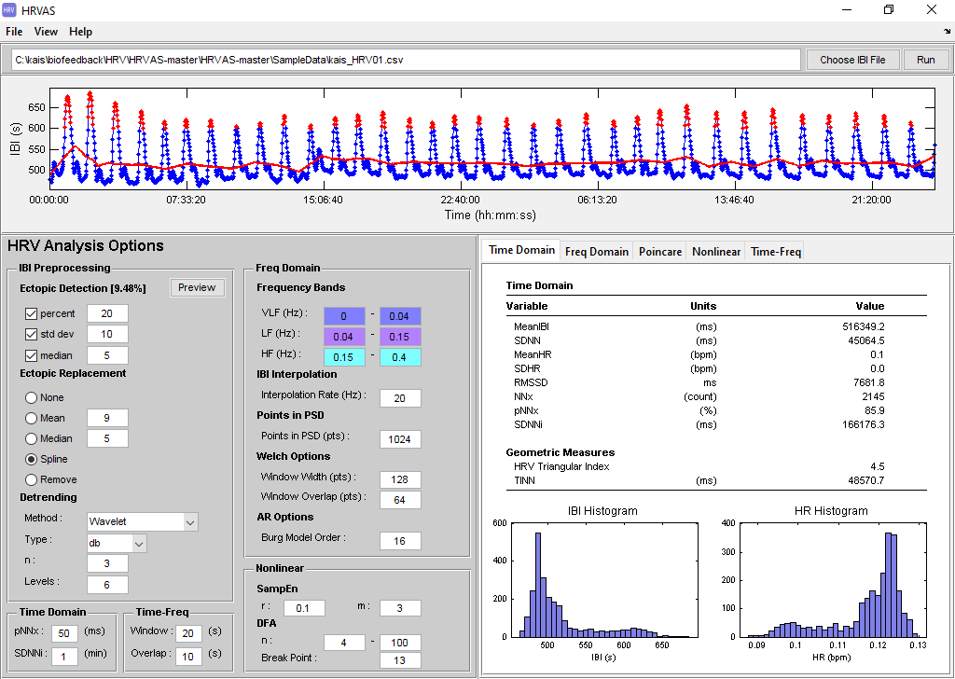
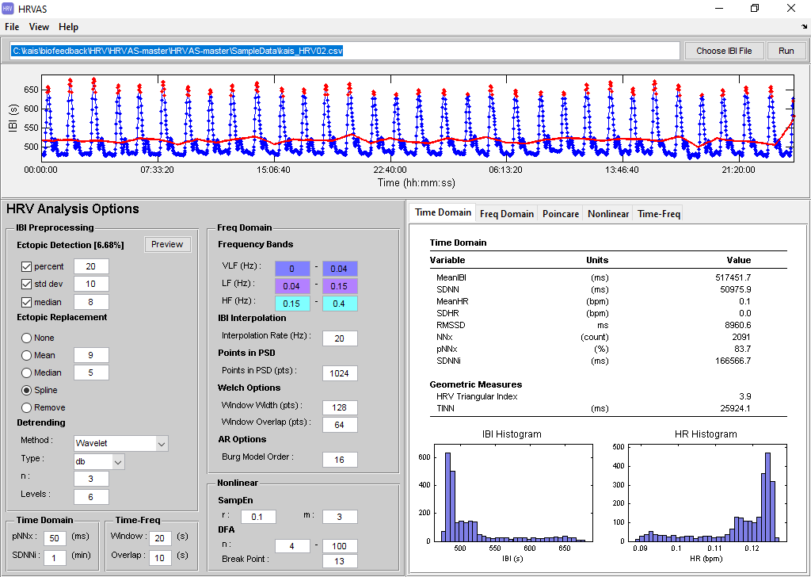
Experimental results
In-Body Condition
Out-Of-Body Condition

Slide 32
Future work
Second alternative with 3D OBE simulation
Other NDE phases
  Space-time geometry & quantum physics
  Acoustic effects
Long-term evaluation
  Quit ego parameters
  Serious game
  Data analysis

Slide 33
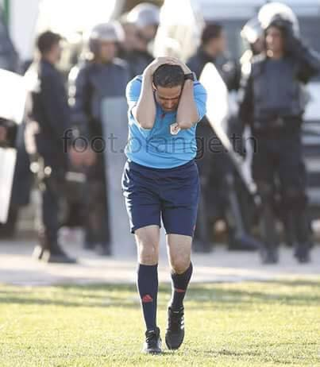
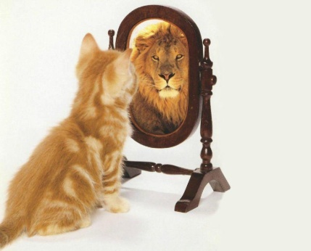


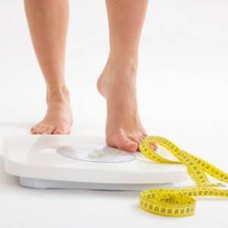

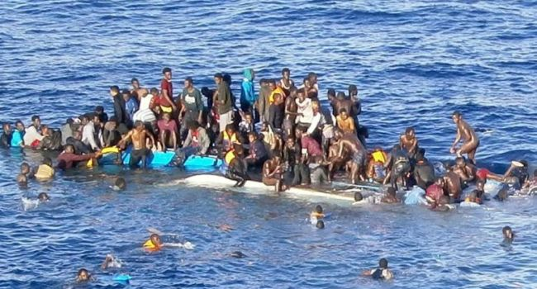
This is our battle
And for this we strive
Thank you
Notes:
33

